Slide 1



Advisory Committee
June 26 to July 19, 2012
www.healthycapitalcounties.org

Slide 2
Agenda
Review purpose and progress
Share findings document
Share dialogue report
What is a Community Heath Improvement Plan?
Priority Strategic Issue Selection
Preparing for September 6th

Slide 3
What is it?
Community Health Profile =
Information that paints an overall picture
of the health of the community
Community Dialogues on Health =
Opportunity for the public to weigh in on
health needs and ideas for improvement.
Community Health Improvement Plan =
A set of actions that community partners
will take to improve health.

Slide 4
Schedule
Community Health Profile Report
JUNE 2012
Community Dialogues on Health
June 26th to July 19th
Community Health Improvement Plan
FALL 2012

Slide 5
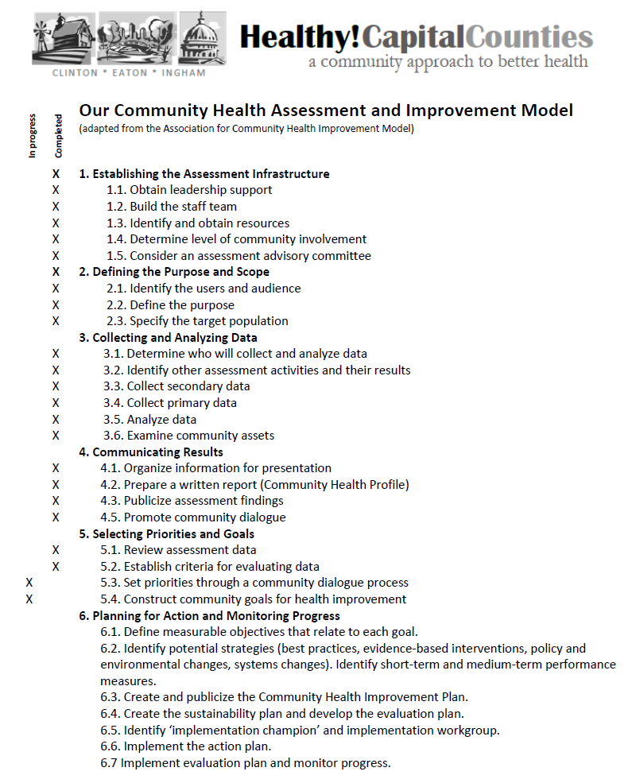

Slide 6
Community Health Assessment:
Quick Overview

Slide 7






Our Model for How Health Happens
Opportunity Measures
Evidence of power and wealth inequity resulting from
historical legacy, laws & policies, and social programs.
Social, Economic, and Environmental Factors
(Social Determinants of Health)
Factors that can constrain or support healthy living
Behaviors, Stress, and Physical Condition
Ways of living which protect from
or contribute to health outcomes
Health Outcomes
Can be measured in terms of quality of life (illness/
morbidity), or quantity of life (deaths/mortality)

Slide 8
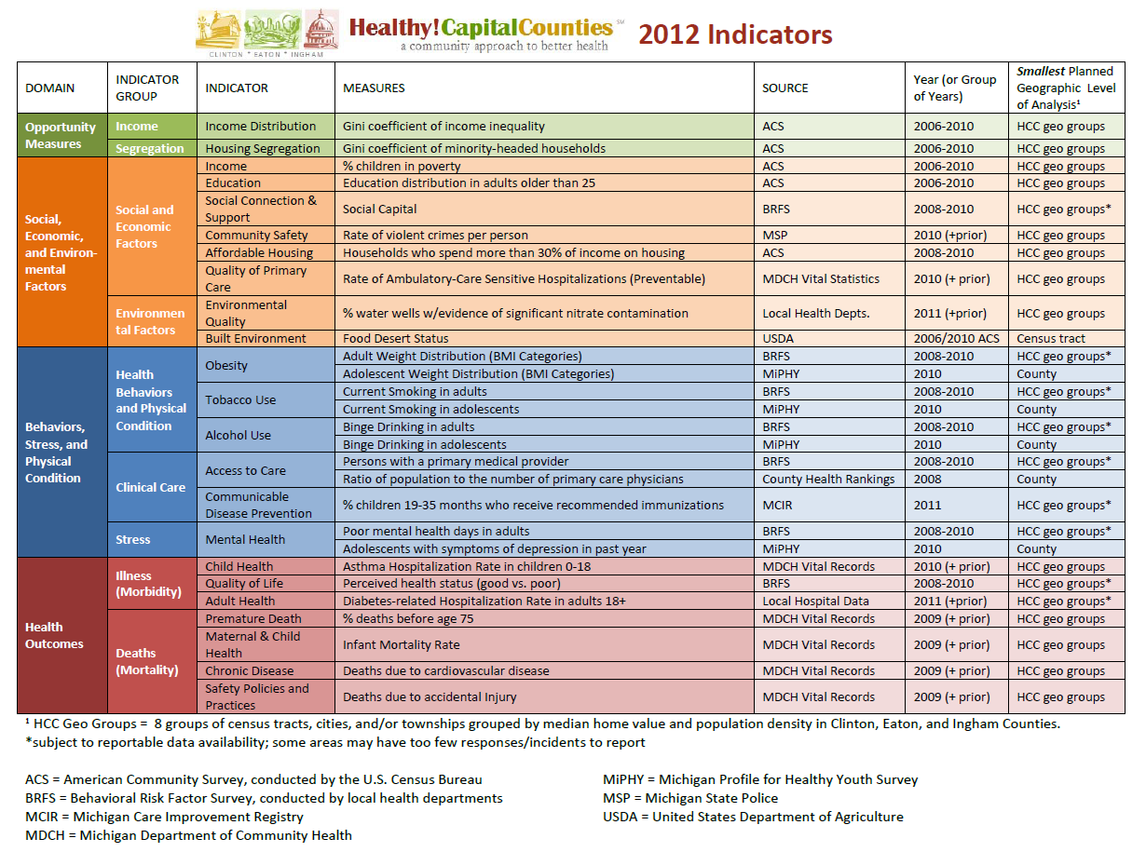

Slide 9
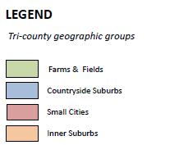
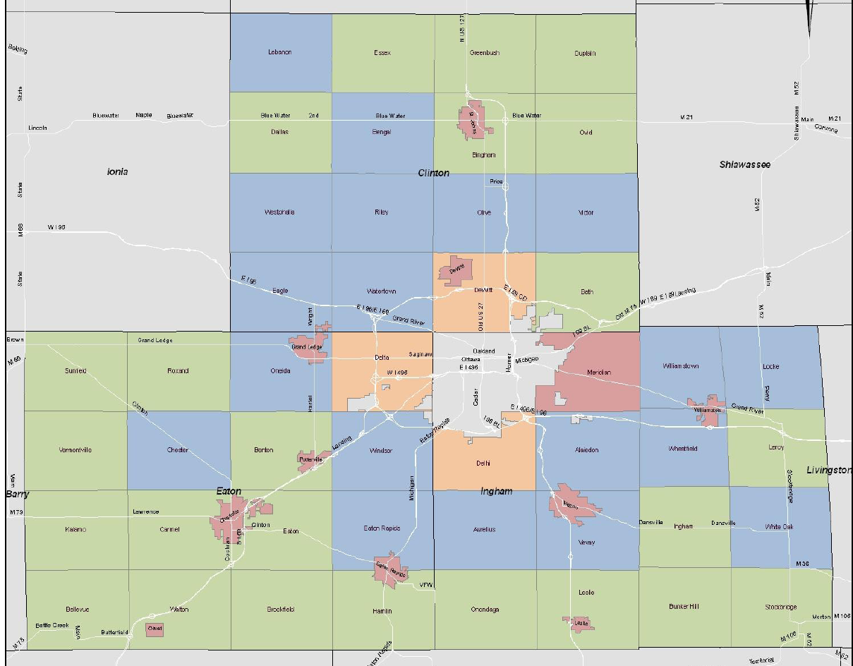
Non-urban Areas

Slide 10
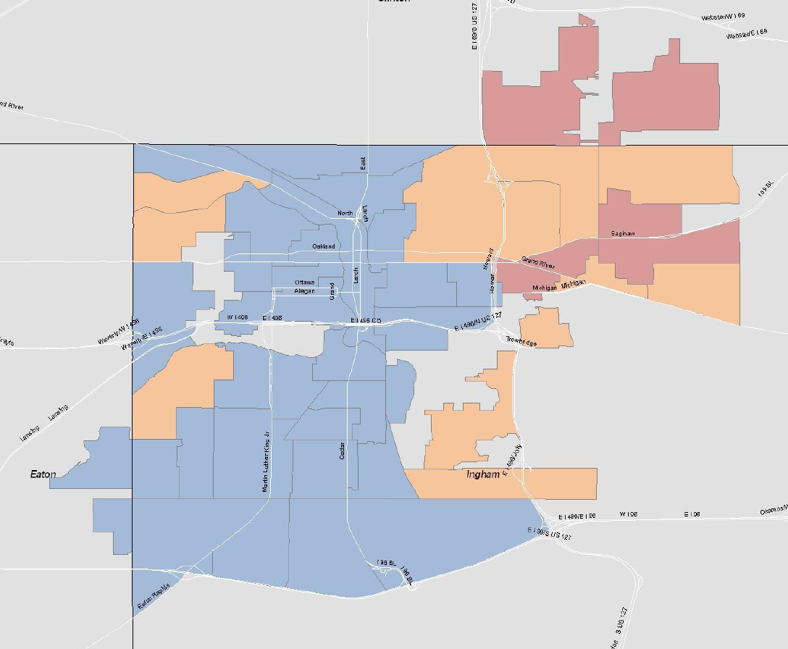
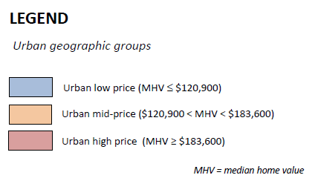
urban Areas

Slide 11
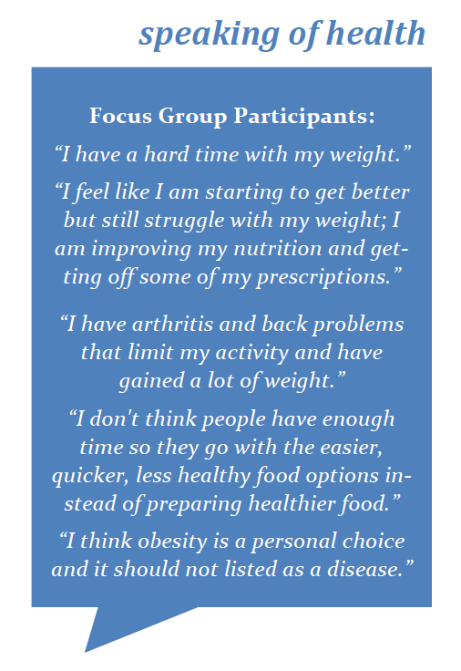
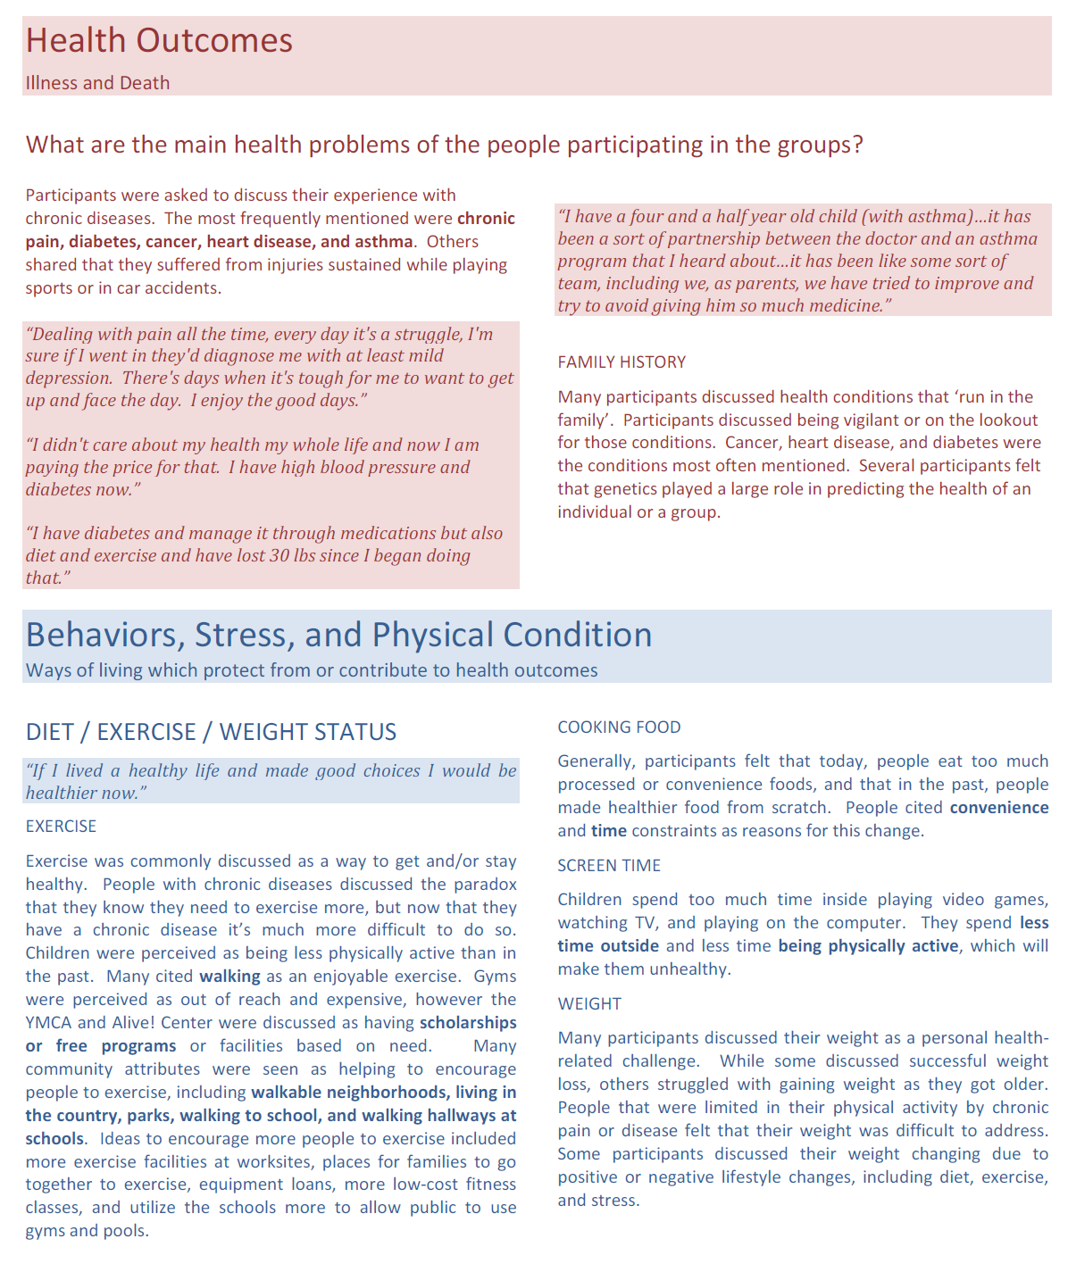

Slide 12
Findings Document

Slide 13
Community Dialogue Report

Slide 14
Community Health Improvement Plan
Onto the next Phase…
So, what is the Community Health Improvement Plan, really?

Slide 15
Priority Strategic Issues
  Can be thought of as a “key problem area”, or something that is strategically important to improving health.
  Can be one of the indicators
  Can be a group of indicators
  Can be an issue that cuts across many indicators
  There are typically 3 to 6 in a plan.
  One issue in the H!CC plan must address a social determinant of health which results in health inequity (grant requirement)

Slide 16
Examples…
Peoria, IL:
Obesity
Oral Health
Reproductive Health
Community Health System Collaboration

Slide 17
Examples…
Kent County, MI:
1. Increase access to affordable healthcare to promote equal access to high quality, affordable healthcare.
2. Increase the number of providers available that accept Medicaid or offer low-cost/free services
3. Reduce disparities in adequacy of prenatal care
4. Increase healthy eating by ensuring access to healthy foods
5. Reduce the disparity in health risk factors and protective factors between students

Slide 18
Examples…
Kitsap County, WA
Ensure access to affordable medical, behavioral health, and dental care for all residents
Make it easy for all residents to be physically active
Ensure all residents have healthier food options
Promote economic development that provides living wage jobs with benefits
Ensure all children and youth receive the support necessary to be healthy throughout life

Slide 19
So, how do we pick?
  Seriousness – How serious is it?
Degree to which the problem leads to death, disability, and impairs one’s quality of life.
Control – How much control over it do we have?
  Degree to which we have influence, authority, or power over this issue.
  Capacity – Do we have the assets and resources to address?
  Ability to reasonably combat the problem given available resources, knowledge, skills.
  Catalytic – Does this issue affect other issues?
  Degree to which this issue, if addressed, would automatically solve other issues.

Slide 20
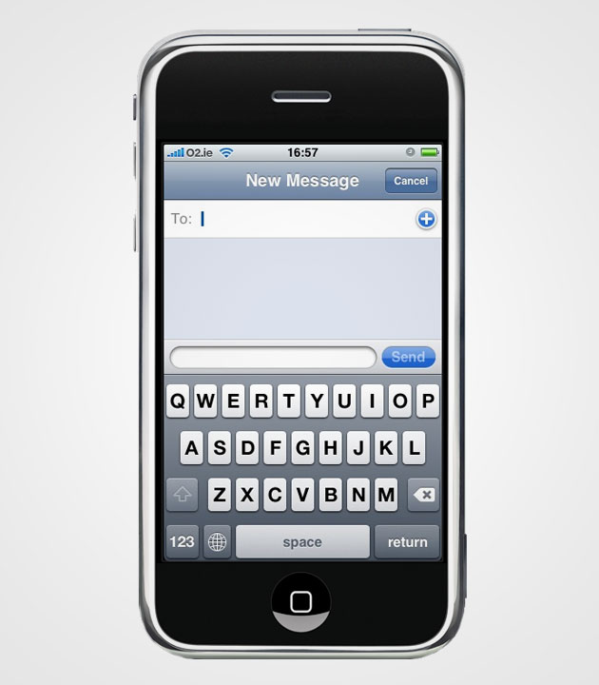
Vote by Texting:
In the “TO” line, you will always enter, “22333”
In the subject part of the message, you will type the code for a specific answer.

Slide 21
Don’t forget: You can copy-paste this slide into other presentations, and move or resize the poll.
Poll: Which factor is the second most importan...
Notes:
Poll: Which factor is the second most importan...
Press F5 or enter presentation mode to view the poll
In an emergency during your presentation, if the poll isn't showing, navigate to this link in your web browser:
http://www.polleverywhere.com/multiple_choice_polls/LTg5MTM3MjMzMA
If you like, you can use this slide as a template for your own voting slides. You might use a slide like this if you feel your audience would benefit from the picture showing a text message on a phone.

Slide 22
Don’t forget: You can copy-paste this slide into other presentations, and move or resize the poll.
Poll: Which factor is the third most important...
Notes:
Poll: Which factor is the third most important...
Press F5 or enter presentation mode to view the poll
In an emergency during your presentation, if the poll isn't showing, navigate to this link in your web browser:
http://www.polleverywhere.com/multiple_choice_polls/MTA4MTA3MzUyOA
If you like, you can use this slide as a template for your own voting slides. You might use a slide like this if you feel your audience would benefit from the picture showing a text message on a phone.

Slide 23
Don’t forget: You can copy-paste this slide into other presentations, and move or resize the poll.
Poll: Which factor is the least important to c...
Notes:
Poll: Which factor is the least important to c...
Press F5 or enter presentation mode to view the poll
In an emergency during your presentation, if the poll isn't showing, navigate to this link in your web browser:
http://www.polleverywhere.com/multiple_choice_polls/Njk3NDAxNjM3
If you like, you can use this slide as a template for your own voting slides. You might use a slide like this if you feel your audience would benefit from the picture showing a text message on a phone.

Slide 24
So, what do we pick from?
Community Dialogues help us by asking community members …
“In order to have the biggest possible impact on the health of the community, what should we focus on?”
We have, essentially, a list of potential priority strategic issues resulting from the dialogues.

Slide 25
Community Dialogue Priorities
(listed in order from most detail provided in strategies to least strategies suggested)
Access and Utilization of Community Resources
Access to Healthy Food
Access to Quality Healthcare
Safe and Connected Neighborhoods/Communities (incl. Community Safety, Social Connection, Injury)
Health Education (incl. behavior education, school health)
Overall Educational Achievement (access to higher ed)
Mental health (incl. stress, depression, access)
Access to Physical Activity
Financial Stability (incl. Poverty and Income Distribution)

Slide 26
But, wait…
There are lots of potential priority issues that might be apparent in the data report, that weren’t discussed at the dialogues.
The FINDINGS document provides additional priority issues to consider, from both:
  Indicator Areas of Concern (table with dots)
  Focus Group Participants’ priorities.

Slide 27
Additional areas of concern identified in the Findings of the Community Health Profile (grouped by color)
Housing Segregation
Housing Affordability
Environmental Quality
Tobacco Use
Alcohol Use
Child Health (incl. School Health, preventable hospitalizations)
Maternal and Infant Health (incl. infant mortality)
Quality of Life (feeling sick)
Premature Death (dying early)
Chronic Disease (incl. cardiovascular and diabetes)

Slide 28
Now, you get to decide!

Slide 29
Save the Date! September 6, 2012
Plymouth Congregational Church
2001 East Grand River Avenue, Lansing, 48912
Meeting divided into workshops based on on strategic issues. 9 am to 4:00 pm
Issue 1 will be from 9:00-10:00 , and so on…
Based on which issues you have most knowledge, passion, experience, influence in, please self select which of the workshops you will participate
We will be reviewing proposed goals, selecting strategies, and identifying potential partners
At the end, we will have our draft CHIP!

