Slide 1
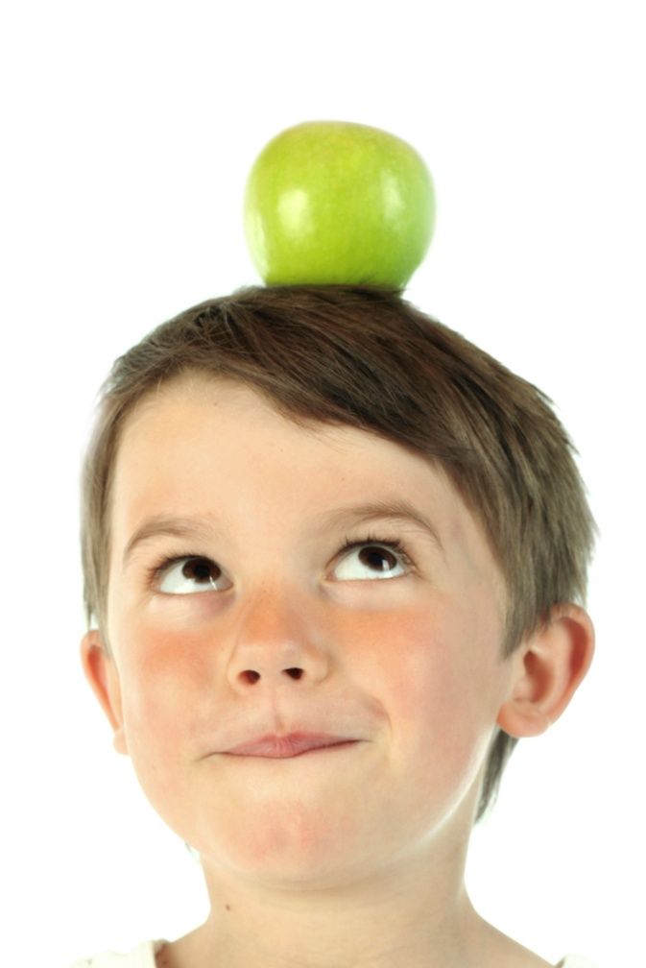
Community
Advisory Committee
May 3, 2012
www.healthycapitalcounties.org

Slide 2
VISION
The vision of the Healthy! Capital Counties Community Health Improvement Process is that all people in Clinton, Eaton, and Ingham Counties live:
In a physical, social, and cultural environment that supports health
In a safe, vibrant, and prosperous community that provides many opportunities to contribute and thrive
With minimal barriers and adequate resources to reach their full potential

Slide 3
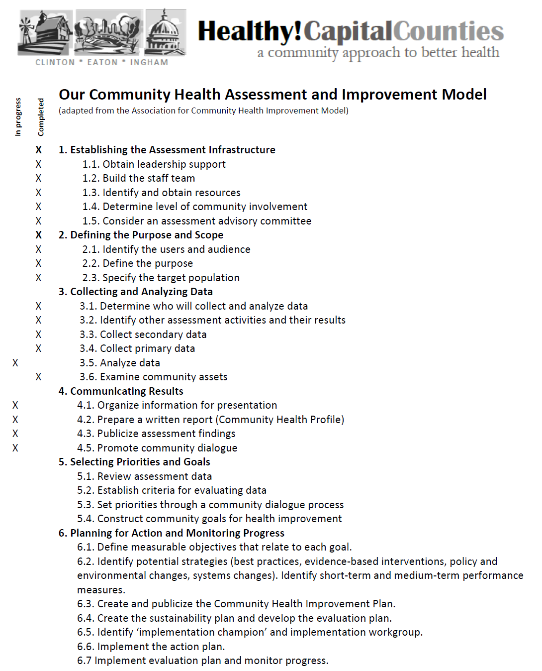
Analyze Data

Slide 4
Schedule

Slide 5
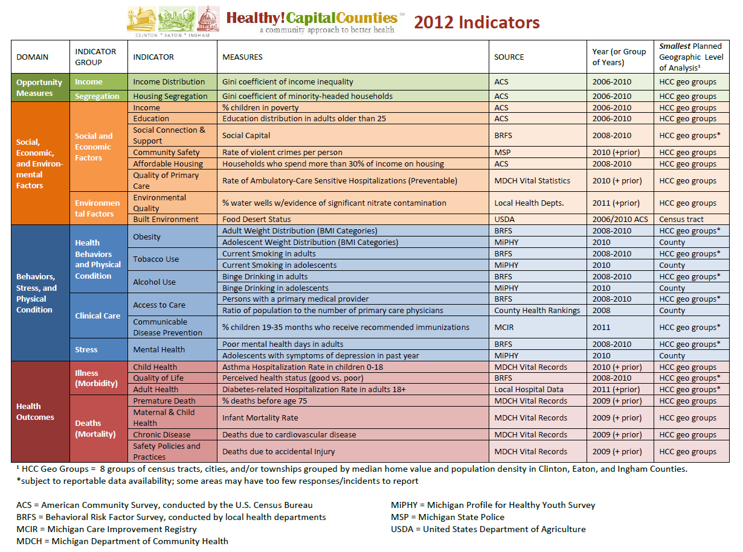

Slide 6
Community Health Profile Report
Indicators Section
Geographic Groups Section
Focus Groups Section

